Slide 1
Bus Safety – Post-Primary Years 8-10
Be Smart, Be Safe, Be School Bus Aware
Notes:
SLIDE 1
BUS SAFETY AWARENESS YEAR 8 - YEAR 10.
This presentation was created by DfI Road Safety Promotion and Outreach. The purpose of the presentation is to educate pupils about road safety issues associated with bus travel on route to and from school. It will also raise their awareness of the dangers encountered as a pedestrian both before and after the journey. The presentation is aimed at pupils in Post-Primary Years 8-10 (Key Stage 3).
Everyone is a road user. During this presentation we will explore what measures pupils can take to ensure their safety. The majority of school bus-related collisions occur before boarding or soon after leaving the bus. Pupils need to stay alert and be aware of their surroundings to stay safe.
You are encouraged to establish any relevant history of incidents (or near misses) involving pupils from the school prior to delivering the presentation as this information will help you make the messages feel more relevant and real to your pupils. Where possible put situations in context by using recognisable place/street names to make it more real for them.
Avoid causing undue stress by stating at the start of the lesson that if they, their family or friends have been involved in a collision or affected in any way and feel uncomfortable during the presentation that have the option to leave the room and await a member of staff.
Even if you travel to school daily on the bus you must always be alert and aware of your surroundings and ensure that you stay safe.
Not paying attention could result in a serious collision that would cause devastating consequences for you, your friends/family, and the whole school community. It only takes a moment’s lapse of concentration to cause death or serious injury.
Always expect the unexpected and never take risks while travelling by bus or crossing the road.
Did any of the class do their Cycling Proficiency Scheme (CPS) in Primary School?
If yes, ask what they learned by doing the CPS and did this help their general road safety knowledge?
Discussion Questions:
What do you think bus safety means?
Who is responsible for road safety?
What does road safety mean to you?
What do you think are the most important road safety issues?
Does your school participate in Cycling Proficiency Scheme (CPS) and are the children keen to participate?
Do any of the pupils remember having a road safety presentation at this or previous schools?
If yes – what did they learn and/or remember?
Do pupils have any experiences they want to talk about and share with the class/group?
Who is responsible for road safety?
Pupils may think it is the responsibility of PSNI, NIFRS, School Crossing Patrol, drivers, or even their parents. However, you should emphasise that: ALL ROAD USERS ARE RESPONSIBLE FOR THEIR OWN SAFETY AND THAT OF OTHER ROAD USERS. EVERY ROAD USER HAS TO TAKE PERSONAL RESPONSIBILITY. ULTIMATELY YOU ARE RESPONSIBLE FOR YOUR OWN SAFETY.

Slide 2
Your Journey to the Bus Stop
Always use the footpath, where available
Walk on the inside of the footpath, away from traffic
If there is no footpath available, walk on the right hand side of the road, facing oncoming traffic
If you have to cross any road, use the Green Cross Code!
Notes:
SLIDE 2
PEDESTRIAN SAFETY
Pupils may be subconsciously convincing themselves that road safety has nothing to do with them.
We all have a natural inclination to think we are invincible and during adolescence this view can be very strongly held. That is part of the reason adolescents have a tendency towards greater risk taking than older, more experienced road users.
However, we are all a pedestrian at some stage when using the road, and we need to be aware of and understand our own vulnerability if involved in a road traffic collision. As a pedestrian we will always come off worse in a collision with a vehicle.
Many young people nullify their senses by listening to music through earphones, texting/talking on their mobile phone, engaging in horseplay, etc. when out and about and as a result are not concentrating on what is going on around them on the road. This places them in potential danger of a collision with another road users, in particular vehicles such as cars, lorries, and buses.

Slide 3
Crossing the road
First, find a safe place to cross
Stop just before you get to the kerb
Look all around for traffic and listen
If traffic is coming, let it pass
When it is safe, go straight across the road - do not run
Keep looking and listening while you cross
Notes:
SLIDE 3
Teachers should emphasise to pupils that while they may think it’s not important to use The Green Cross Code, they are not safe if they don’t.
Knowing and being able to use the Green Cross Code is a lifeskill for EVERYONE (young and older) who use the road as pedestrians.
Remember - even if you are late for the bus you should never take risks when crossing the road.
Teachers should point out the following:
Sometimes the quickest route is not always the safest route to take.
Look for a safer place to cross even if you have to walk a bit further? Is there a pedestrian crossing available or a stretch of road with good sight lines for looking for traffic?
If there are no safe places to cross do you use the Green Cross Code or take a risk and just go for it?
Do you remember learning the Green Cross Code at primary school? If so, do you still use it? Do you use it subconsciously without really thinking?
The Green Cross Code is a short step-by-step procedure designed to assist pedestrians to cross roads safely:
1. Find a safe place to cross;
2. Stop just before you get to the kerb;
3. Look all around for traffic and listen;
4. If traffic is coming, let it pass;
5. When it is safe, walk straight across the road;
6. Keep looking and listening while you cross.
Road traffic collisions are the cause of many unexpected deaths and serious injuries across Northern Ireland. We often hear the news headlines when someone has been killed on the road – however, behind each death is a devastated family and group of friends who are plunged into grief and trying to come to terms with their loss.
What are the implications for you and others of poor pedestrian behaviour? Very often we do not hear about those that are seriously injured and who’s lives and the lives of their families are never the same again. Perhaps a lifelong ambition to move into a particular career, travel, or have a family of their own is cruelly ended by injuries sustained in a crash. Many loved ones lives are changed in an instant with the need to become a long term or even full-time carer for a relative involved.
What can YOU do to ensure that YOU do not become another statistic?
What should you consider if you have to cross the road?
Have you ever endangered yourself or others as a road user? e.g. dashing out into the road in front of a car, crossing where it is difficult for drivers to see you, or being distracted by mobile devices while crossing the road.

Slide 4
Dangerous places to cross
Notes:
SLIDE 4
DANGEROUS PLACES TO CROSS
Discuss the examples listed on the slide that create a hazard for pedestrians trying to cross the road:
Near a corner
Between parked cars
Either side of a hill
Near a dip in the road
Where vision and clear sight lines are impaired, consider safer places to cross nearby – you may have to walk a little further but it may mean the difference between life and potential death!
Ask pupils about their attitude to speed and how they judge when it is safe to cross the road as pedestrians.
Stopping distances depend on the speed and size of the vehicle, tyre tread, brakes, weather conditions, etc.

Slide 5
Distractions
Notes:
SLIDE 5
DISTRACTIONS – MOBILE PHONE – Any Electronic Portable Device
It is common place today for young people to have a mobile phone, mp3 player/iPod or other portable device. These devices are used to interact with friends, play games or listen to music. They require our concentration and focus, to the extent that we may not be fully aware of other things going on around us.
When using the road we are engaging in a potentially hazardous activity especially if we allow ourselves to be distracted and we don’t give our full attention to what is happening around us on the road.
To ensure we use the roads safely we need to:
Avoid using a mobile phone or portable media player when on or near the road (so you can hear vehicles, approaching emergency vehicles and can concentrate on crossing the road).
Follow the rules of the road and practice the Green Cross Code.
Do you ever listen to music or use your mobile phone while out walking? If you are reading a text, talking on a mobile phone or listening to music then you are not fully concentrating on the road. Never use a mobile phone or listen to music while walking, especially when you are crossing the road.
HOW DID YOU GET TO SCHOOL?
Conduct a hands up survey to ascertain how pupils travelled to school e.g. walk, bicycle, bus or car.
Some may travel by car and return by bus or even a combination of methods for just one journey.
Ask:
Do they think the way they travelled was safe?
What risks do they experience on route?
Could it be safer?
How could it be safer?
Could you incorporate a safer place to cross by walking a bit further?
Emphasise: the quickest route is not always the safest route to take!

Slide 6
At the Bus Stop
Make sure you have your bus money and/or pass
Stand well back from the kerb particularly as the
bus pulls into the bus stop.
Don’t mess around with your friends.
If you’re listening to music or using your phone
while you wait for the bus. Stop using it as the
bus approaches.
When the bus arrives don’t push or rush to get on
the bus - let other passengers get off the bus first.
Notes:
SLIDE 6 – AT THE BUS STOP
Just because your older doesn't mean it’s safe for you. One bad decision is all that it could take to become a statistic.
Teachers should emphasise the importance of keeping safe when around school buses – emphasise how big these vehicles are compared to young people and how difficult it is for a bus driver to see them in his mirrors.
Make sure you’ve got enough money and/or your pass for the journey.
Discuss why it is important to stay safe while at the bus stop:
– stand in a safe place (in an orderly queue), away from the road;
– do not play at the bus stop as you could end up getting hit by a vehicle if you fell onto the road.
If required, indicate to the driver you want the bus to stop by walking 2 steps forward and holding your arm out as it approaches then move back from the edge of the kerb before the bus stops.
Don’t rush or push to get on the bus - take your time - remember its important to be safe!
If your bus doesn’t turn up, don’t panic – return to school and report to the office or a teacher.

Slide 7
Winking Bus Lights
All school buses must be
fitted with winking lights
This shows other drivers that the bus is loading/unloading passengers
Notes:
SLIDE 7 – WINKING BUS LIGHTS
FACT: Pupils are more at risk getting on and off a school bus than travelling on it.
Look out for the illuminated signs and flashing warning lights that have been phased in over recent years on school buses. Buses are fitted with illuminated signs and flashing warning lights, making them much easier to see, particularly in poor weather conditions.
Signs must be illuminated at all times when children are travelling to and from school on a “school service”.
The flashing warning lights must be turned on while children are getting on and off the bus, and for between 4 and 8 seconds after the door is closed.
Please ensure that pupils understand that there is still a need for them to take care when crossing the road after getting off a bus. They still need to take responsibility for their own safety. It is best to stand on the footpath until the bus has moved away in order to be able to see clearly in both directions (and be seen!).

Slide 8
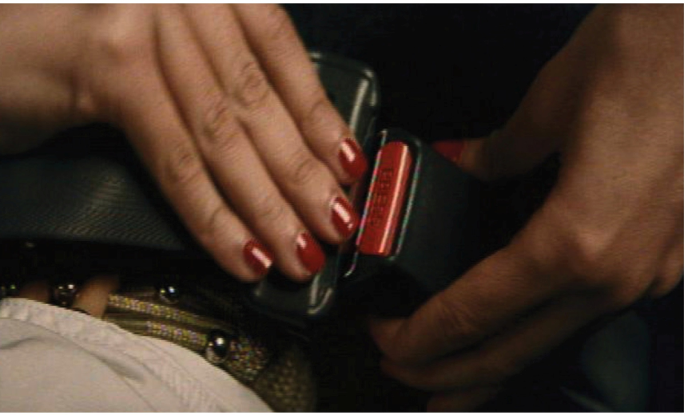
On the Bus
Don’t push or shove
Store your bags safely keeping the aisle clear
Sit in a seat and put on your seatbelt (if fitted)
Never distract the driver
Never throw things on the bus or out the windows
Never play with safety equipment on board the bus
Give up your seat for the elderly and disabled people
Stand behind the driver when waiting to get off the bus
Notes:
SLIDE 8 – GET ON THE BUS SAFELY
Buses are the safest mode of transport while you are on them. The dangers are getting on and off.
Remember to stay back from the kerb as the bus approaches, buses are so long that part of the front of the bus (known as the nose) may encroach on the pavement as it approaches the bus stop.
Discuss – Ask pupils for their experiences travelling to school by bus (collisions / near misses).
Some tips for using the bus:
Wait for the bus to stop completely before approaching it; STAND BACK
Make sure you have the correct money and/or your bus pass;
Place your school bag safely out of the way of other passengers;
Go to the first available seat and put your seat belt on properly;
Do not distract the driver;
Do not throw things on the bus or out the window;
Never mess around with the safety equipment;
When approaching your stop, keep your seatbelt fastened until the bus comes to a stop;
Take all your belongings when leaving the bus;
If you drop something while exiting the bus, alert the driver, as he may not see you;
Stand clear from closing bus doors;
When exiting the bus, look right (and left for cyclists);
Wait for the bus to drive away before crossing the road.
Remember seat belt law applies on all buses and minibuses – where a seat belt is fitted it must be worn at all times!
Remember you are representing your school and to behave sensibly on the bus!
REMEMBER MOST TRANSLINK BUSES HAVE CCTV CAMERAS ON BOARD!

Slide 9
Never cross behind the bus
Wait until the bus drives away!
Notes:
SLIDE 9 – NEVER CROSS BEHIND THE BUS
If you have to cross a road after getting off a bus, ALWAYS let the bus move away so that you can get a clear view of the road in each direction before crossing.
A number of fatalities and serious injuries of this nature over the past 10 years in Northern Ireland have been in YOUR age group.

Slide 10
Remember the following rules
& travel safe
1. Signal – if you need to let the driver know you want on the bus
2. Stand back from the kerb until the bus has stopped and the door opens
3. Allow any passengers to get off
4. Don't push or shove
5. Sit down and always wear your seatbelt where one is provided
6. Store your bags safely
7. Don’t distract the driver
8. Give your seat up for the elderly and disabled
9. Wait until the bus has stopped before removing your seatbelt and leaving your seat
10. Never walk out in front of, or behind, the bus
Notes:
SLIDE 10
Summary
Teachers should remind pupils of the 10 bullet points outlining the key messages in this presentation.

